Slide 1


Udemy Data Analysis
By

Slide 2
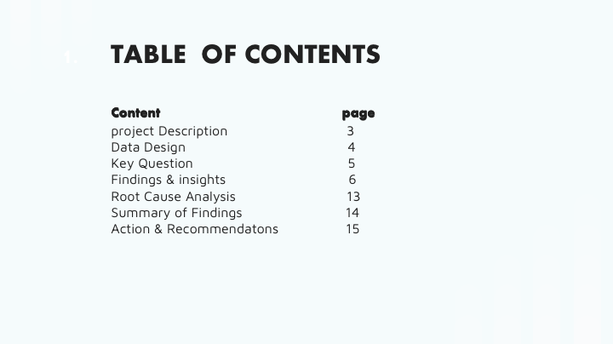

Slide 3

Project Description:
To better understand the pricing and subscriptions data of Udemy courses (for four different subjects) and identifying trends and patterns
This will help us to:
Identify for which subject more courses should be created
Create targeted strategies to increase the company revenue

Slide 4
Key questions:
What are the total numbers of subscribers in each subject?
How does the average content duration/price/number of students vary across different subjects?
How many courses are free and paid for each subject?
What is the average price of web development courses at different levels?
What are the 20 most popular courses? Also, include the following information: - Their level - Whether they are free or paid - Whether any are free beginner courses, - and the duration of the courses.
Does content duration impact the price of the course?

Slide 5
Findings & Insights

Slide 6
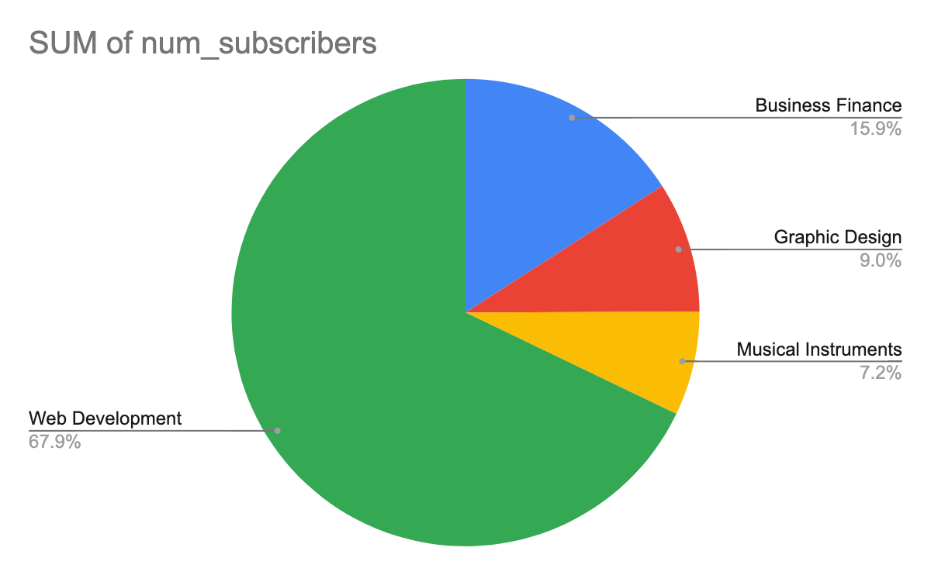
What are the total numbers of subscribers in each subject?
Key Findings
Web Development has the highest susbcribers taking 67.9% of the chart.
Musical Instrument takes 7.2% of the chart which is the lowest
Add visualizations here

Slide 7
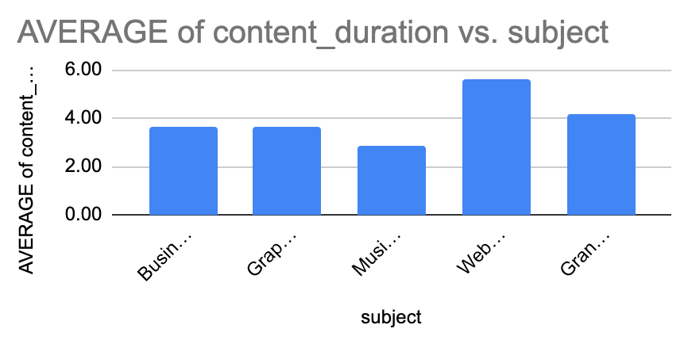
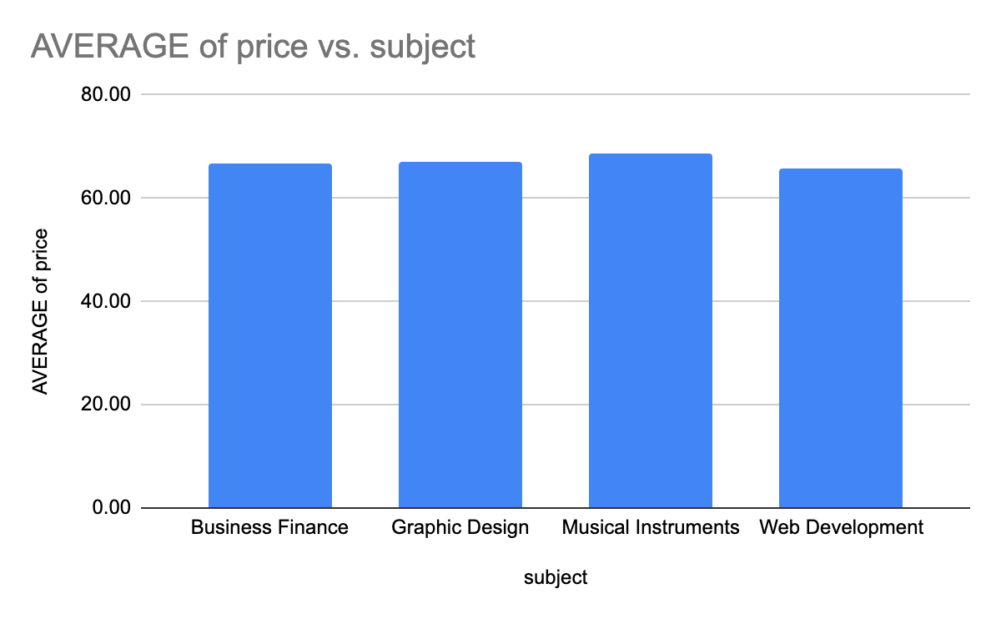
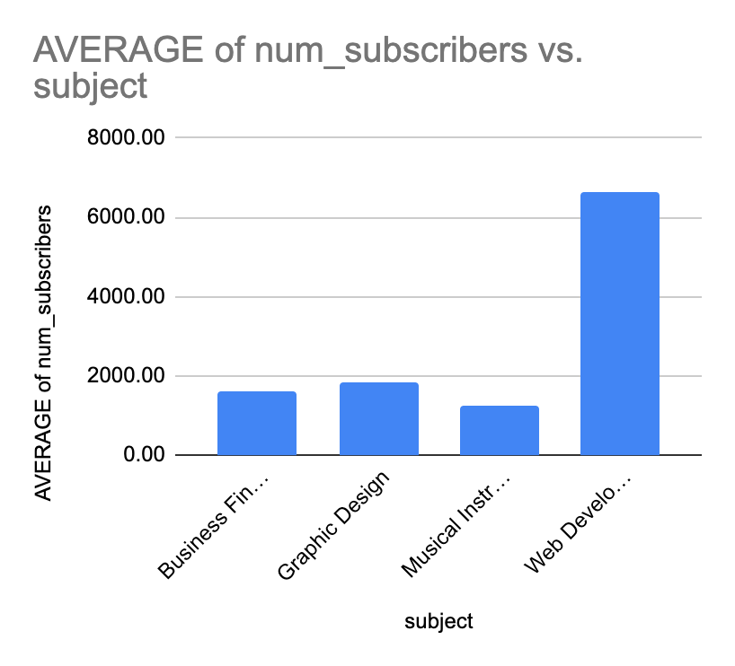
2. How does the average content duration/price/number of students vary across different subjects?
Key Findings
Web Development has the highest duration of content.
Musical Instrument has the highest average of price.
Web Development has the highest average of num of subscriber.

Slide 8
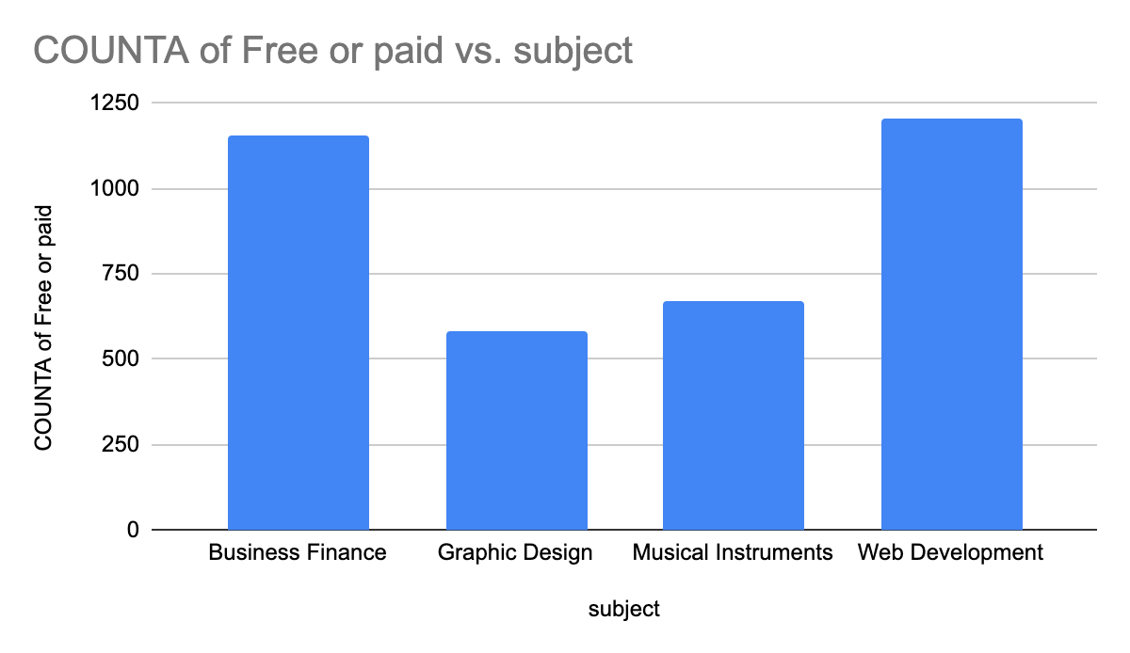
3. How many courses are free and paid for each subject?
Key Findings
Add visualizations here
Add brief summary of what the visualizations tell us - your key find
Web Development has 1203 paid and free courses.
Business Finance has 1155 paid and free courses.
Musical Instrument has 669 paid and free courses.
Graphic Design has 584 paid and free courses.

Slide 9
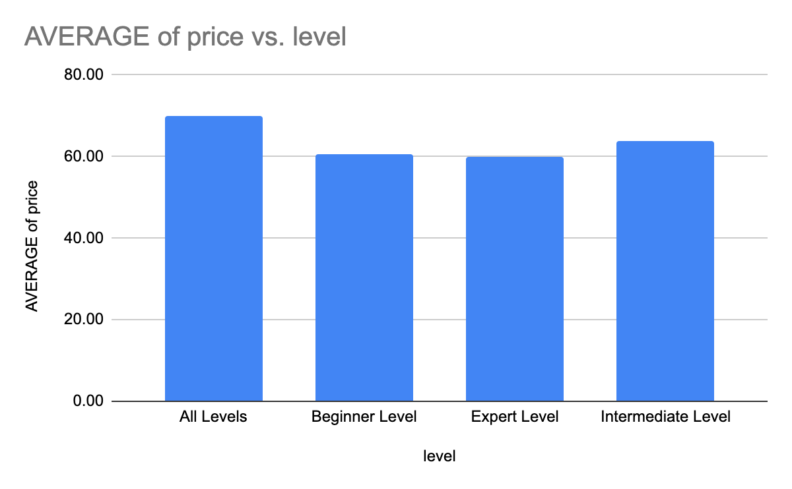
4. What is the average price of web development courses at different levels?
Add visualizations here
Add brief summary of what the visualizations tell us - your key find
Key Findings
The average price of Web Development at All Levels is the highest with 70.03 average price.
Expert Level has the lowest average price with 60.00.

Slide 10
5. What are the 20 most popular courses?
course_title
Learn HTML5 Programming From Scratch
Coding for Entrepreneurs Basic
The Web Developer Bootcamp
Build Your First Website in 1 Week with HTML5 and CSS3
The Complete Web Developer Course 2.0
Free Beginner Electric Guitar Lessons
Web Design for Web Developers: Build Beautiful Websites!
Learn Javascript & JQuery From Scratch
Practical PHP: Master the Basics and Code Dynamic Websites
JavaScript: Understanding the Weird Parts
Pianoforall - Incredible New Way To Learn Piano & Keyboard
Angular 4 (formerly Angular 2) - The Complete Guide
Beginner Photoshop to HTML5 and CSS3
Web Development By Doing: HTML / CSS From Scratch
HTML and CSS for Beginners - Build a Website & Launch ONLINE
Become a Web Developer from Scratch
Bitcoin or How I Learned to Stop Worrying and Love Crypto
Quickstart AngularJS
Learn Responsive Web Development from Scratch
Learn and Understand AngularJS
Key Findings
Learn HTML5 Programming from scratch is the first as seen in the table, Learn and Understand AngularJS is the last.

Slide 11
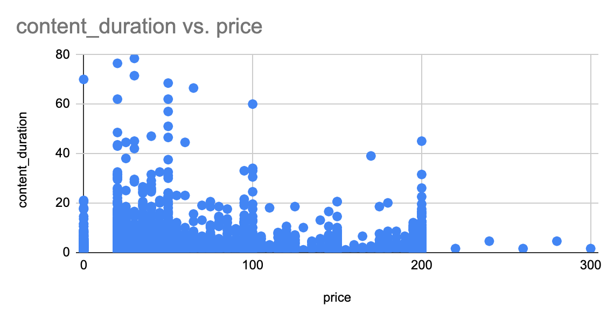
6. Does content duration impact the price of the course?
Add visualizations here
Add brief summary of what the visualizations tell us - your ke
Key Findings
From the table and the chart the content duration does not affect the price of the course.

Slide 12
Summary of findings:
Top 5 courses:
Almost 68% of subscribers come from Web Development and the top 5 courses are for Web development as well
Business Finance vs Web Development:
Business Finance and web development have almost equal number of total courses (1155 vs 1203), but web development course are almost 2x in content duration and have 4x the average subscribers
Course Pricing:
Web development has the highest average price at All level, and it has the highest number of paid and free courses

Slide 13


Slide 14
Recommended actions:
Product recommendations:
Focus on getting more paid course by creators in Web development.
Marketing recommendations:
Our data tells us that our web development courses are most popular and people are willing to pay for it. Marketing and advertising campaigns should therefore focus on Web Development to get more people interest in it.

Slide 15

Summary

Slide 16
Thank you!

